Slide 1
Embodied AI week 17
- Shaoqin Li

Slide 2
goals
Presentations in the last couple weeks are researching ideas and complete training workflow on R1 theoretically
Now it’s time to explore R1 in a practical way
Plan for next couples weeks: replicate my work on R1
Plan for this week: Load the R1 model, make it stand

Slide 3
configuration
git clone https://github.com/unitreerobotics/unitree_rl_mjlab mjlab is the official Unitree RL repo and easy to find unitree robot models
3 main components found in the R1 directory: XML, R1_constant.py, and STL mesh files

Slide 4
STL
STL stands for Standard Tessellation Language or Standard Triangle Language
It's one of the most common 3D file formats in robotics and engineering.
describes the 3D shape of a physical part as a collection of triangles. Every surface is broken down into tiny triangles that together approximate the shape.
MuJoCo uses STL files for two purposes:
1. Visual mesh : what you actually see rendered in the viewer. The detailed, smooth-looking robot geometry.
2. Collision mesh : simplified version used to detect when two parts touch each other. Usually simpler than the visual mesh for performance.

Slide 5
R1.XML
Contains robot structure info of R1 like bodies, joints, collision shapes, sensors and etc

Slide 6
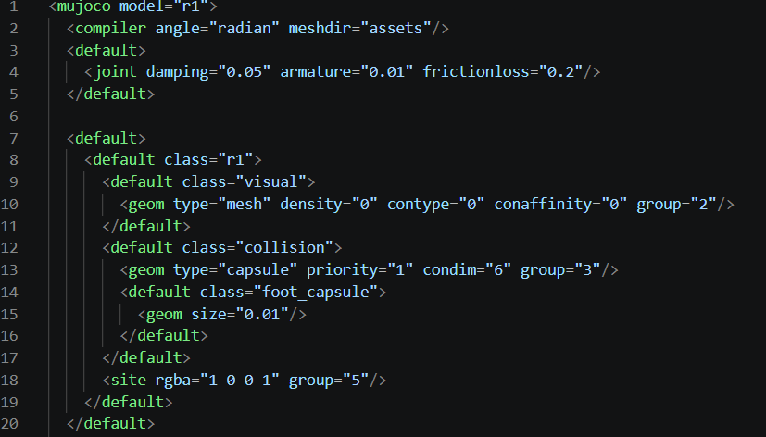
R1.XML setting and defaults
Opens mujoco file, names the model to r1
Set angle to radian
Tells Mujoco to look for STL files under subfolder ‘assets’ to relate to the call
Set rendering configuratioins

Slide 7
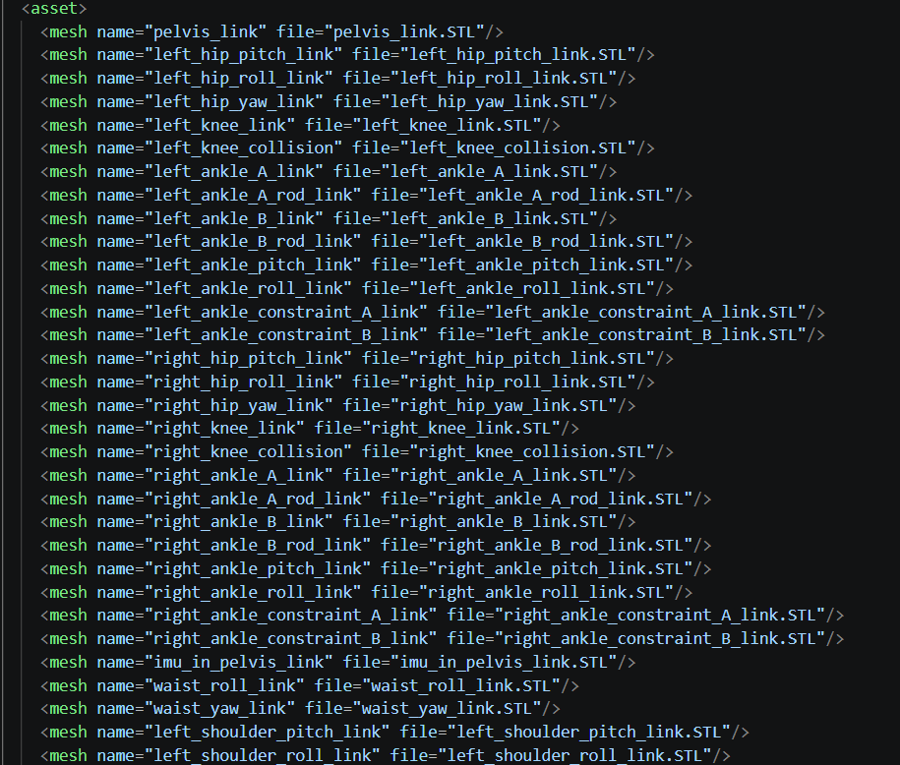
R1.XML Asset Section
Loads all STL mesh files into memory and gives each one a name. Later in the file, geoms reference these by name instead of file path. Every body part has its own STL file.

Slide 8
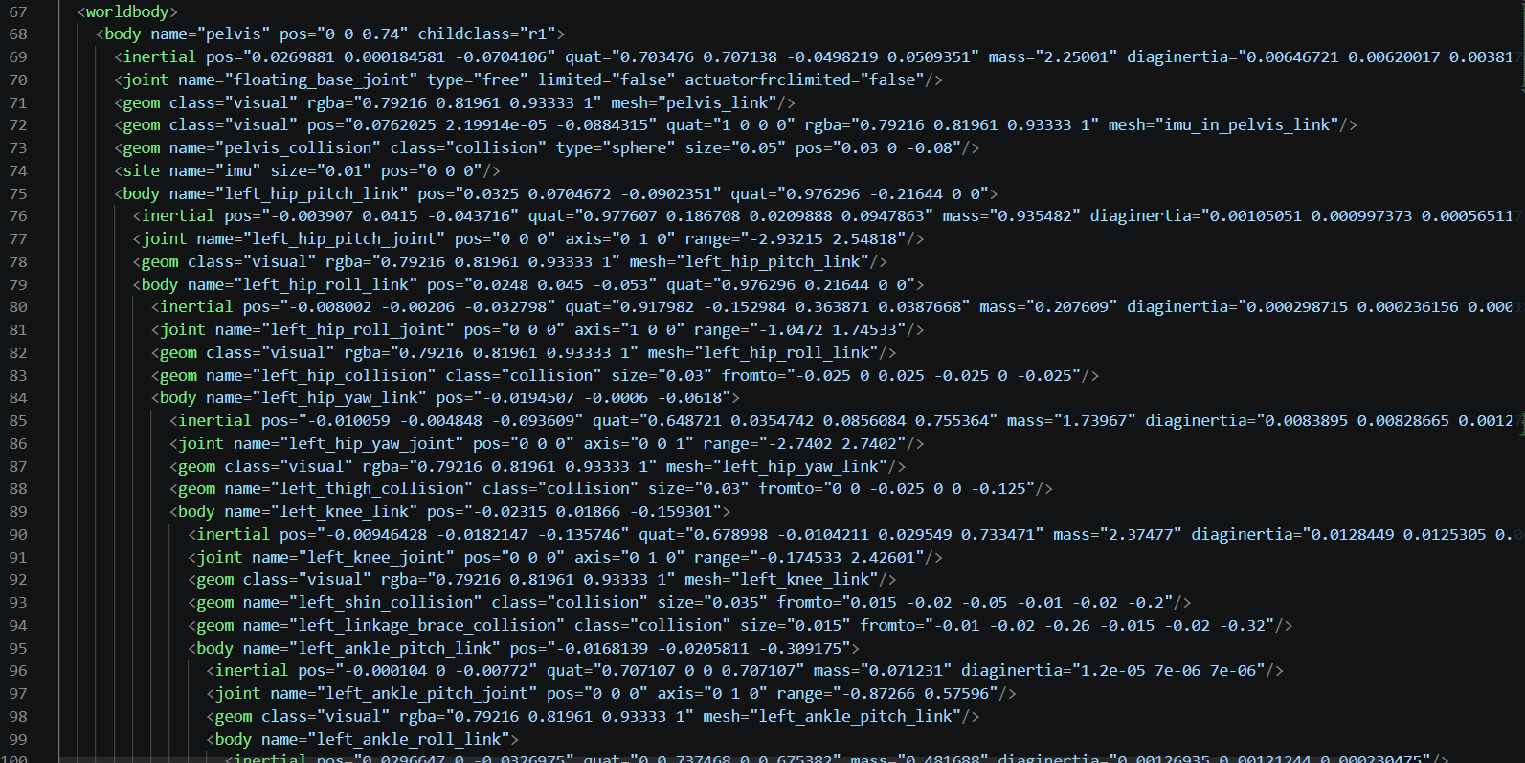
R1.XML World Body
Everything inside here exists in the simulation world. The ground plane goes here, lights go here, and the robot body tree goes here.

Slide 9
R1_constants.py
Contains actuator config, home pose, collision config

Slide 10
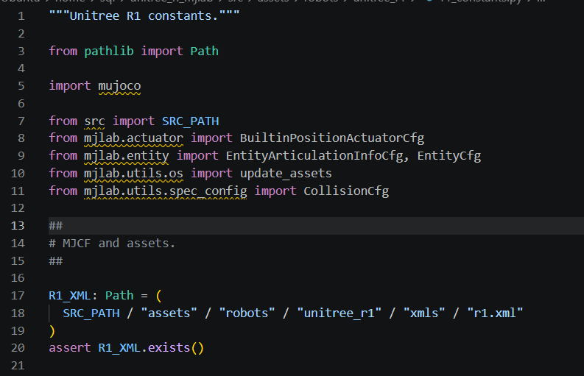
R1_constants.py
Calling mjlab classes, ensuring calling path

Slide 11
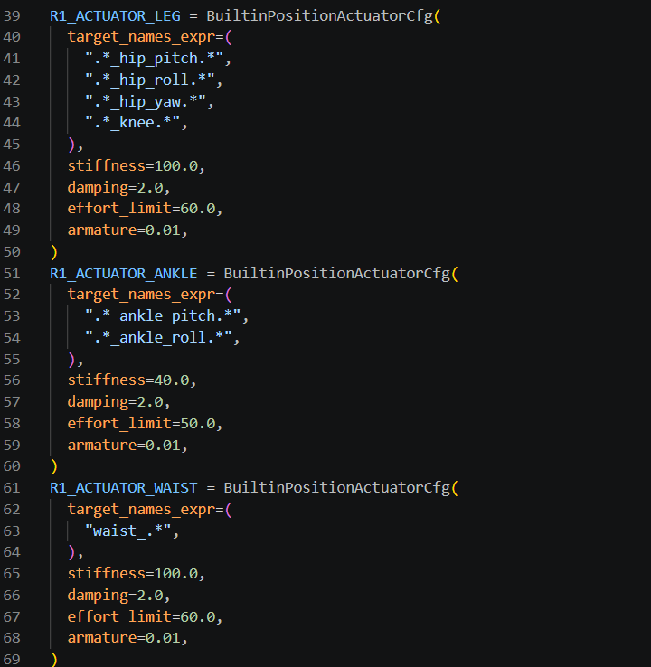
R1_constants.py
Defines a position controller for all joints:

Slide 12
Loading R1 on Mujoco
After understanding the structure of these files. We can upload the model and render it on Mujoco
Found the correct names for R1 actuators and add it to the XML file

Slide 13
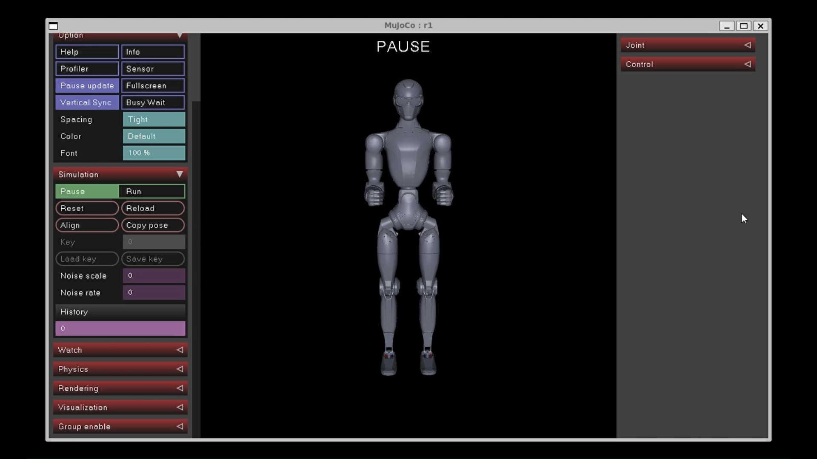
Result

Slide 14
Add a ground plane
Add a floor geom to the XML

Slide 15
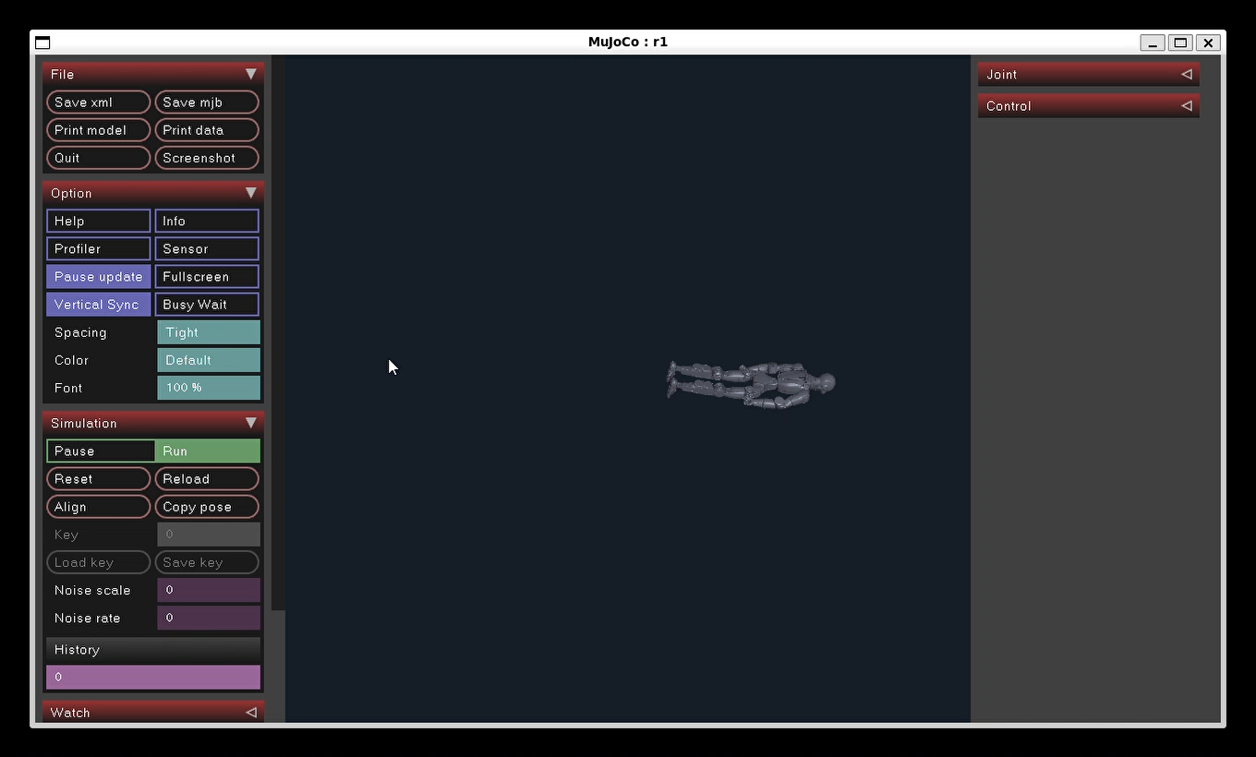
Result

Slide 16
Standing
After making sure the model is able to load and have proper physics properties (falling onto the ground plane), we can head to the next phase : standing
I created a script controlling the controllers to put forces to the joints and make it hold

Slide 17
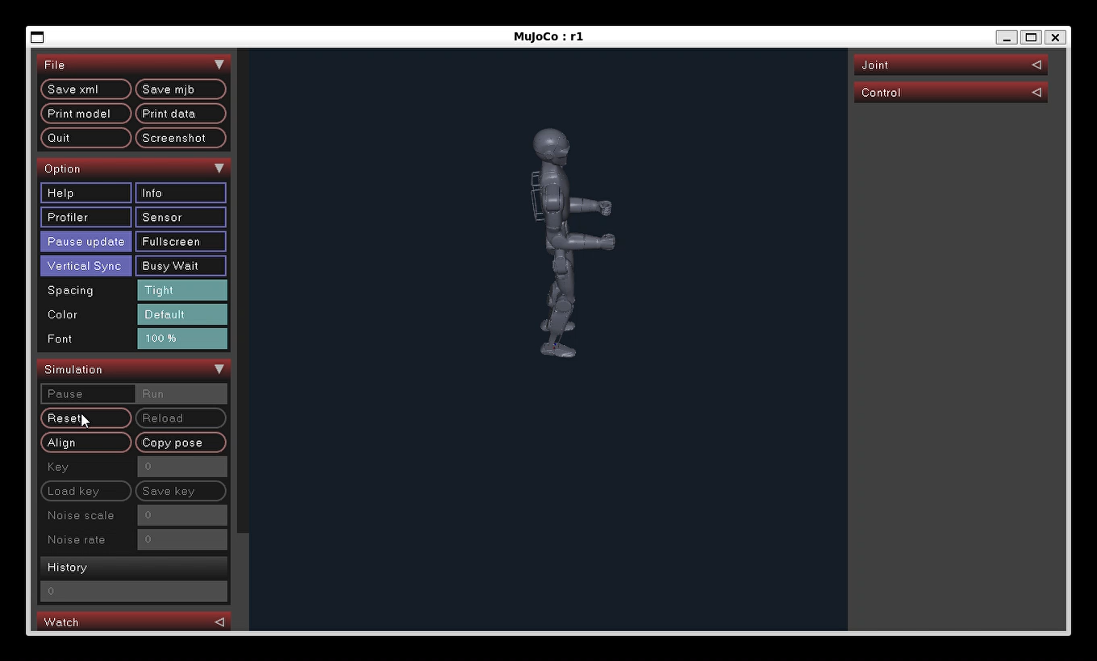
Result

